Slide 1
WELCOME TO PRESENTATION Course Code:CSE-0402 Course Titel:E-commerce & Web Engineering lab Presented By: Farhan mashuk saumik ID:UG02-46-17-005 Batch:46 Department of CSE State University of bangladesh

Slide 2
Project Name:Portfolio

Slide 3
Introduction: I want to creat a portfolio website where my personal life will be described in detail as well as other topics likes new funny videos & pictures.will be given

Slide 4
Features: #Home #About me #Services #skills #Contact #Teams #Portfolio

Slide 5
Programming Language: *HTML *CSS *Java Script

Slide 6
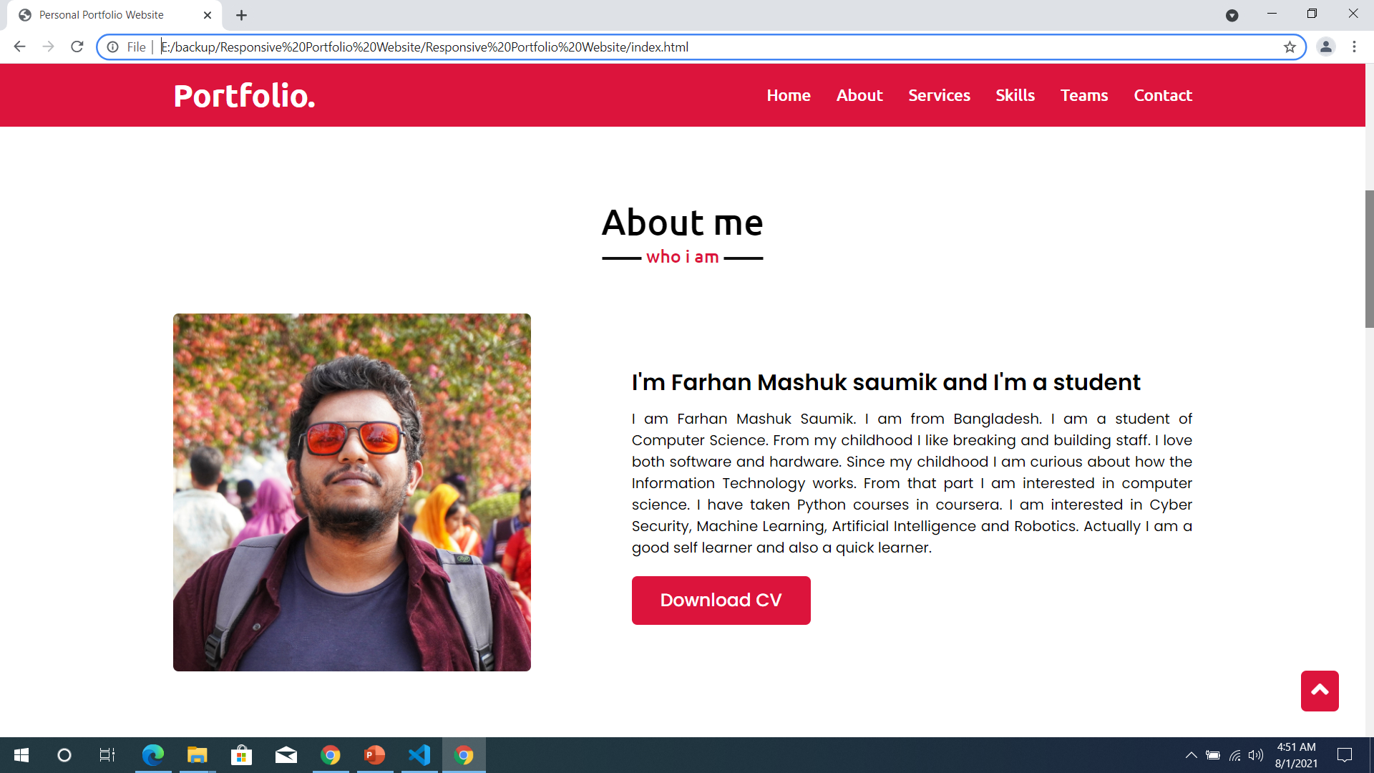
My portfolio interface

Slide 7
Why is it important to have a portfolio website? • Portfolios are a great way to demonstrate the competencies you would list on a resume or talk about in an interview — they allow you to show and not just tell. • During a job search, the portfolio showcases your work to potential employers. • It presents evidence of your relevant skills and abilities.

Slide 8
Future Plan: In future,I want to develop the website and some new features as well as do something interesting for the users,so that they visit this website

Slide 9
Thank You!

